Slide 1
Real Time Parking Space Availability
Gopi Sai Surekha Kotiyala
With
Dr. Terry Griffin
Midwestern State University

Slide 2
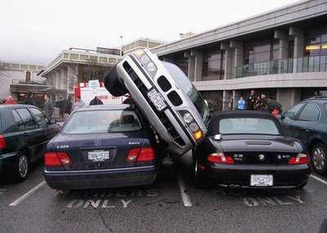

Problem
Late for class … again.

Slide 3
Motivation
Available parking spaces are elusive.
Location Based Services are easy to implement.
Identifying available parking is not easy to implement, but possible, and has an expressed need.

Slide 4
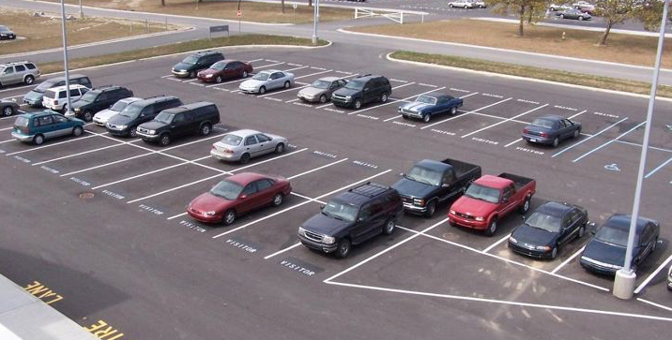
Overview
Identifying Available Parking Spaces has three stages:
Automatic parking space discovery
Identifying spaces as available
Mobile application showing results

Slide 5
Some Terminology
Edge Detection
Object Detection
Corner Detection
Line Detection
Filtering
Color Identification

Slide 6

Application
( on a clean image)

Slide 7

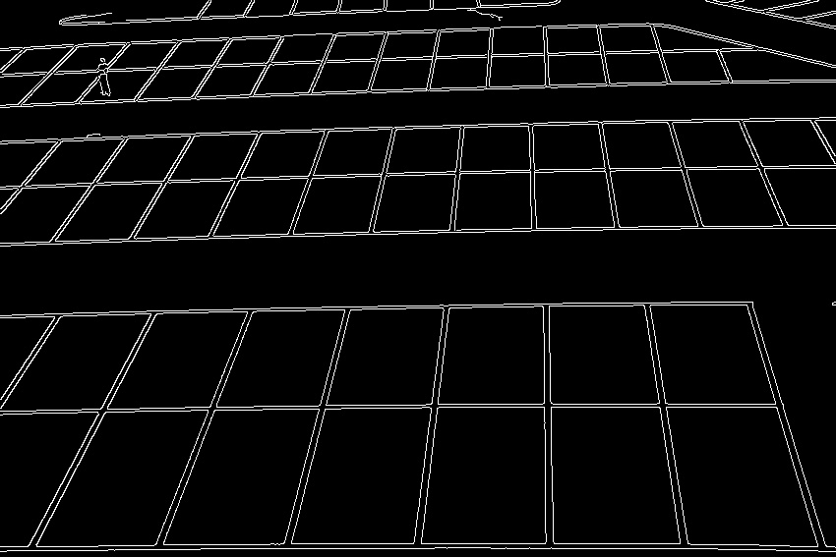

Application
( filters )
Original
Gray Scale
Edged
Closed

Slide 8

Application
( Corners)
Corner Detection

Slide 9
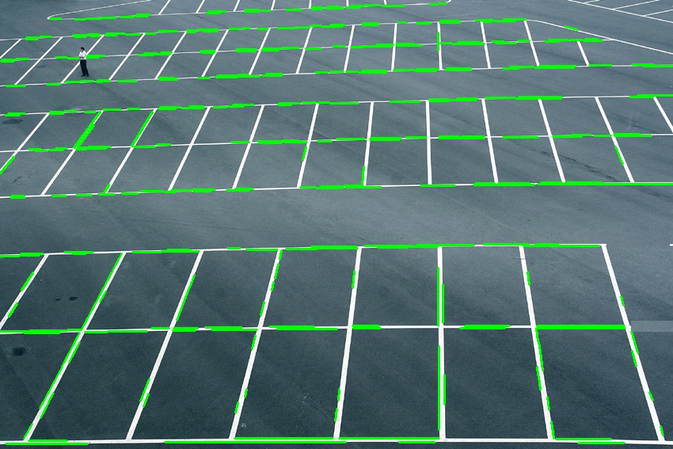
Application
( Lines)
Line Detection

Slide 10
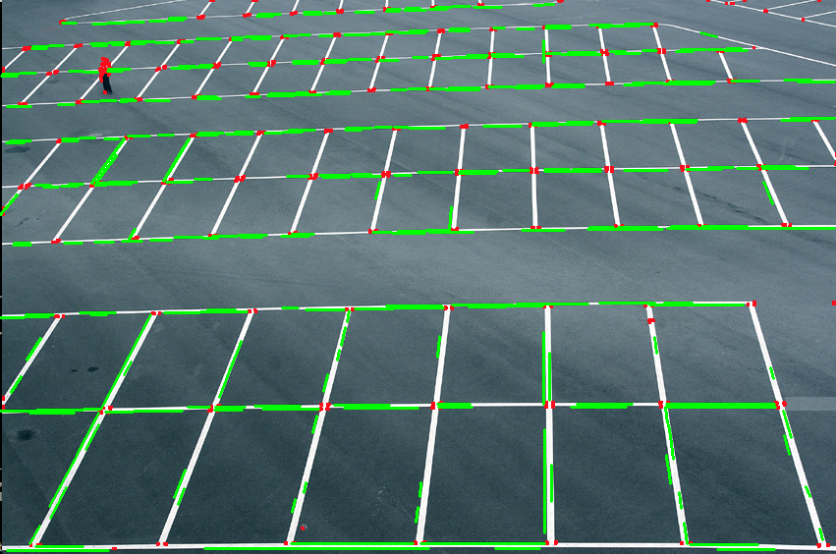
Application
( Lines and Corners)

Slide 11
Problems
A real time robust parking space identification algorithm is possible, but not 100%
We choose to move to Stage 2
Automatic parking space discovery
Identifying spaces as available
Mobile application showing results

